Slide 1
Business Analyst Career Program
Capstone Project

Slide 2
Summary
I understand the data titled "Western countries financial data" and have observed that it contains various dimensions and measures. Among the dimensions, we find different segments, countries, products, discount bands, and dates that populate the data. On the other hand, I have come across measures such as units sold, manufacturing price, sale price, gross sales, discounts, sales, COGS (Cost of Goods Sold), and profit mentioned in the data.
While analyzing the data, I learned about the discount bands, which range from "None" to "Low," "Low" to "Medium," and "Medium" to "High." Within the "High" discount band, I found that the highest discount provided was valued at $149,677.50. In the "Low" discount band, the lowest discount provided was valued at $18.41.
In the "Segment" field, we find that it is populated by segments such as Government, Midmarket, Channel partners, Enterprise, and Small Business. The countries contributing to the financial data are Canada, Germany, France, Mexico, and the United States of America.

Slide 3
Statistical Analysis
I performed Statistical analysis on data by the method of “Measures of Central Tendency” and “Measures of Central Dispersion”.
Introduction
A Measure of central tendency is a single value that attempts to describe a set of data by identifying the central position within that set of data. As such, measures of central tendency are sometimes called measures of central location. They are also classed as summary statistics.
The mean (often called the average) is most likely the measure of central tendency that you are most familiar with, but there are others, such as the median and the mode.
A Measures of dispersion help to describe the variability in data. Dispersion is a statistical term that can be used to describe the extent to which data is scattered. Thus, measures of dispersion are certain types of measures that are used to quantify the dispersion of data.

Slide 4
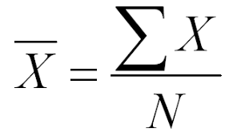
Explanation
As the data was found with no outliers, I performed Arithmetic mean on data.
Mean on the sales of Product “Amarilla” = $ 1,88,799
Mean on the sales of Product “Carretera” = $ 1,48,552
Mean on the sales of Product “Montana” = $ 1,65,492
Mean on the sales of Product “Paseo” = $ 1,63,421
Mean on the sales of Product “Velo” = $ 1,67,432
Mean on the sales of Product “VTT” = $ 1,88,183

Slide 5
Measure of Central Dispersion
Range
Standard Deviation
Variance
Range
I performed range on a field “Discount Band”
Range=Largest value – Smallest value
Low Band Discount Range = $ 48300 - $ 18 = $ 48282
Medium Band Discount Range = $ 102667 - $ 110 = $ 102557
High Band Discount Range = $ 149677 - $ 274 = $ 149403

Slide 6
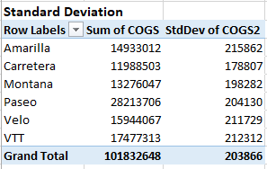
Standard Deviation
The Standard Deviation was performed on COGS of Products.

Slide 7
Conclusion
In the analysis of central tendency, we computed the mean for the data and discovered that the "Amarilla" product has the highest mean value of $188,799.
Regarding the measure of central dispersion, we conducted calculations for both the range and standard deviation. For the high discount band, the range extends to $149,403, for the low discount band, it spans $48,282, and for the medium discount band, it covers $102,557.
In terms of standard deviation, the COGS (Cost of Goods Sold) for the "Amarilla" product was the highest at $215,862, while the lowest standard deviation was observed for the "Carretera" product, which amounted to $178,807.

Slide 8
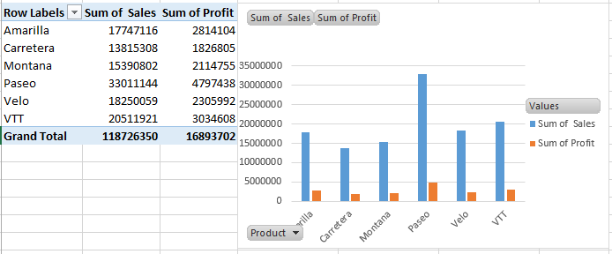
Graphical Analysis
Bar chart Representing Sum of Sales and Profit as per Products.
It can be seen that Product Paseo has both Profit & Sales higher than other product.
Product Carretera has the lowest amount of Sales & Profit.

Slide 9
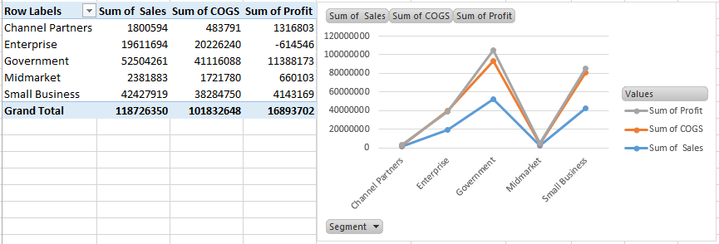
This Line Chart shows Values of Profit, COGS, Sales for different segments.
As per the chart, it can be seen that Profit Margin of Government is the Highest as compared to any other segments.
It is also seen that Enterprise has faced a loss of $ -614546.

Slide 10
This Bar chart Represents the product which is profitable in particular Country.
The Chart shows that Paseo Product has earned highest in Canada, France, Mexico and USA.
Whereas in Germany Velo product has earned highest.

Slide 11
This Line Chart shows Sales timeline on a basis of months.
For Amarilla, pick in sales was seen in month of October. For Carretera, Sales picked up in month of December.
For Montana, sales Hiked in month of April. In paseo, Sales has its highest hike in November. For Veto and VTT, Sales hike was in month of October.

Slide 12
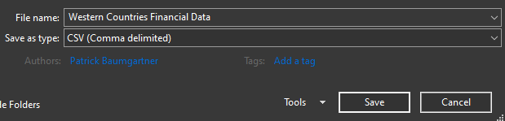
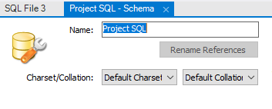
Inserting the data in SQL Server
In order to Import Excel data in Sql Server, first it needs to be converted to CSV file. As MySQL Workbench Supports CSV.
Step 1: Convert to CSV
Step 2: Create New Schema

Slide 13
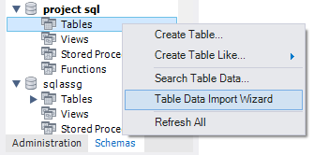
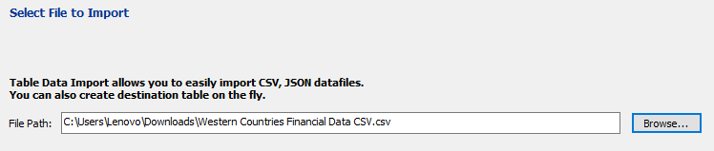
Step 3: Select Table Data Import wizard.
Step 4: Browse data

Slide 14
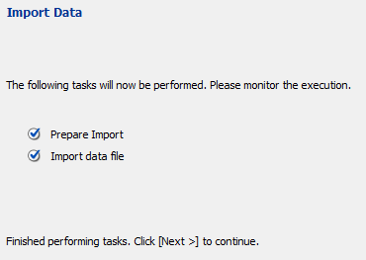
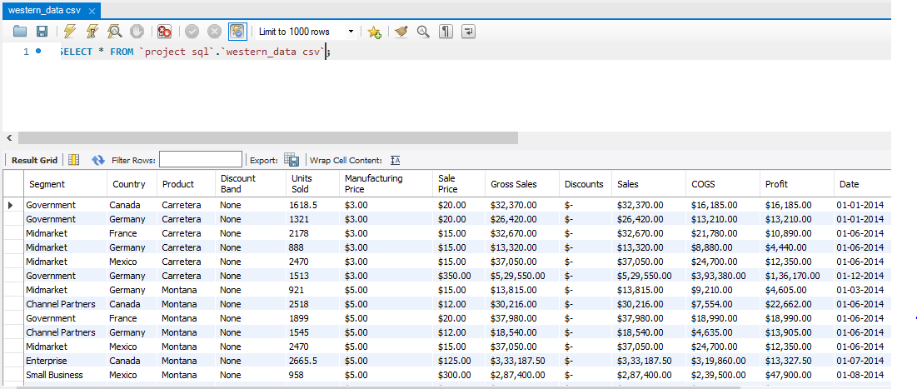
Step 5: Execute Import
Import Finished

Slide 15
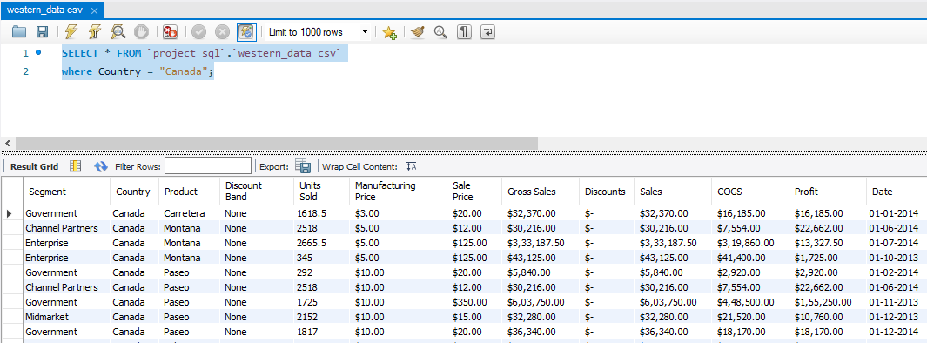
SQL Query
Here you can see the SQL Query performed by Condition, Where Country is Canada.

Slide 16
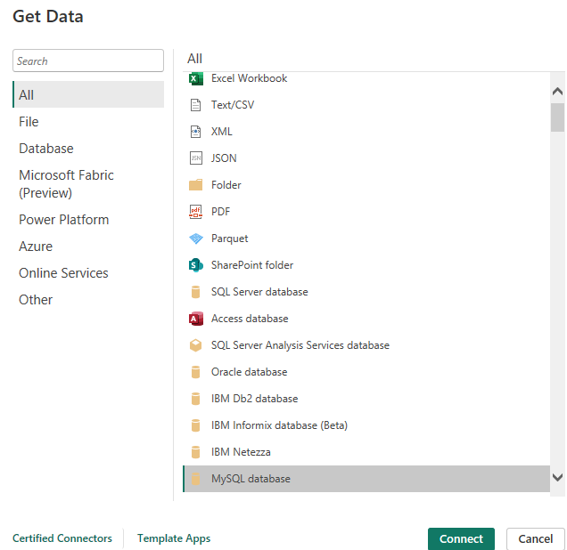
Import Data from the SQL Database into Power BI
Step 1: Go on Get data, Select MySQL database.

Slide 17
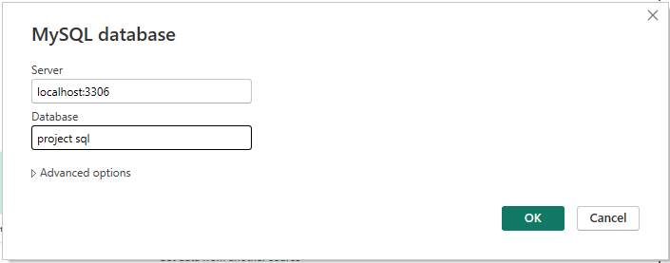
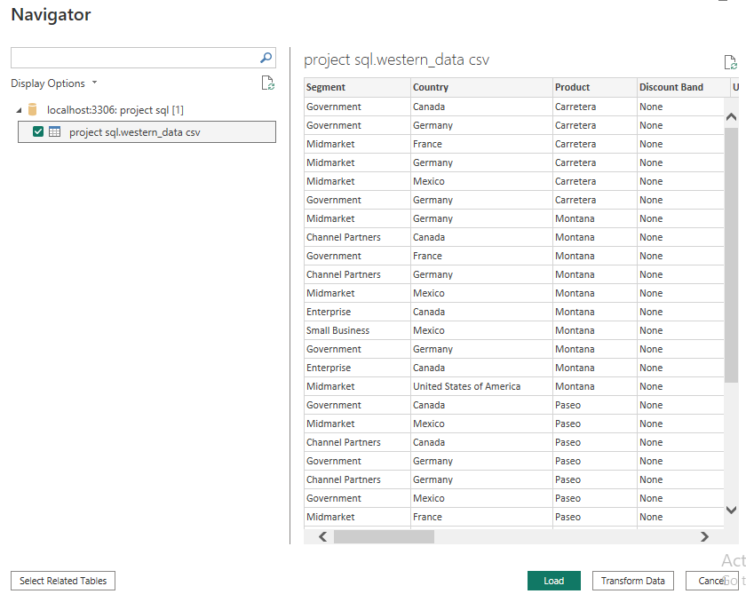
Step 2: Input Server and Database name
Step 3: Select Load or Transform data

Slide 18
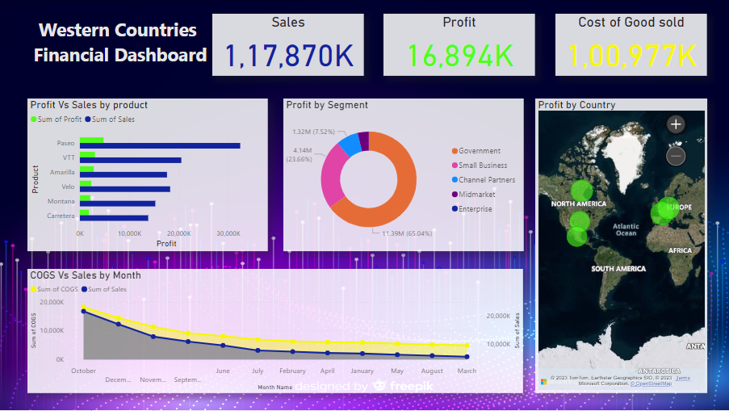
Power BI Dasboard

Slide 19
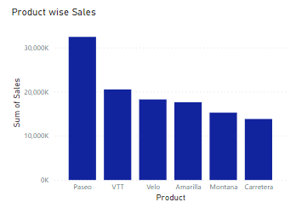
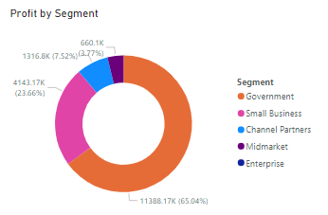
Product Wise Sales
Segment Wise Profit

Slide 20
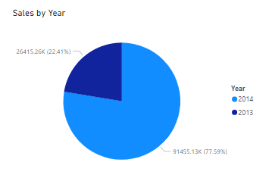
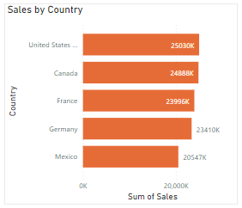
Yearly Sales
Country Wise Sales

Slide 21
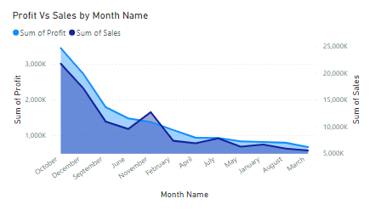
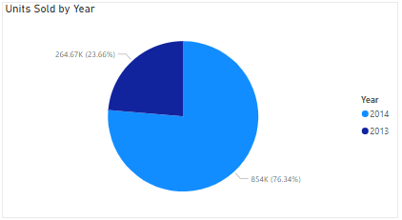
Profit & Sales by Months
No of Units Sold Over a Year

Slide 22
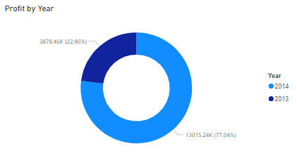
Yearly Profit
Conclusions & Inferences
In the Power BI Dashboard, we encountered various visuals, including cards displaying the total sales, profit, and COGS. There was also a bar chart illustrating the comparison of profit versus sales by product. Additionally, we included a donut chart representing profit by segment. Maps were used to display profit by country. Lastly, we utilized a line chart to show the relationship between COGS and sales on a monthly basis.

Slide 23
Endnotes
Western Countries Financial Data-Excel.xlsx
Power BI Capstone project.pbix

Slide 24
THANK YOU

